Slide 1

STUDENT DETAILS
KRUTHI IPPILI
KRUTHI_IPPILI@SRMAP.EDU.IN
SRM UNIVERSITY ANDHRA PRADESH , AMARAVATI START DATE : 05-06-2024
END DATE : 25-07-2024

Slide 2
PROJECT TITLE/PROBLEM STATEMENT
Project Title: Design and Development of a Student Portfolio Problem Statement:
Explain the need for a digital portfolio for students.
Highlight the challenges students face in showcasing their skills and achievements
online.
Mention the lack of a professional platform for students to present their work.

Slide 3
AGENDA
Introduction
Project Overview
End Users
Solution and Value Proposition
Customisation and Personalisation
Modelling
Results

Slide 4
INTRODUCTION
Today, I am excited to present to you the student portfolio I designed and developed using HTML and CSS. This portfolio showcases my skills, projects, and achievements in a professional and accessible way.
The purpose of this project was to create a digital platform that effectively presents my work and capabilities, while also demonstrating my proficiency in web development technologies and other technologies.

Slide 5
PROJECT OVERVIEW
Description:
The student portfolio project aims to create an online platform where students can showcase their skills, projects, and achievements
Objectives:
To design a visually appealing and professional portfolio.
To highlight key projects, experiences, and personal achievements. To ensure the portfolio is easy to navigate and update.
Key Features:
Responsive design for various devices. Modern and clean layout.
Sections for personal information, projects, and contact details.

Slide 6
WHO ARE THE END USERS OF THIS PROJECT?
Primary End Users:
Students who want to create a professional online presence.
Secondary End Users
Educators and mentors who guide students in their careers.
Peers and collaborators interested in viewing and interacting with students' work.

Slide 7
YOUR SOLUTION AND ITS VALUE PROPOSITION
Solution: The portfolio website offers a centralised platform for the student to present their skills, projects, and contact information
Value Proposition:
For Employers: A quick and easy way to assess the student's capabilities and fit for
job roles.
For Clients: An opportunity to see the student's previous work and gauge their
expertise in web development and design.
For Collaborators: A comprehensive view of the student's skills, making it easier to
identify potential collaboration opportunities.

Slide 8
HOW DID YOU CUSTOMIZE THE PROJECT AND MAKE IT YOUR OWN
The website is designed to be highly customizable and personalized to reflect the
student's unique style and skills
Customizable Elements:
Header and Navigation: Easily update links and add new sections.
Content Sections: Modify text, images, and layout to highlight new skills and
projects.
Design and Style: Change colours, fonts, and overall design to match personal branding.

Slide 9
MODELLING
The website uses a responsive design approach, ensuring it works well on various devices, from desktops to mobile phones
HTML Structure: A semantic structure with sections for easy navigation and readability.
CSS Styling: Utilizes modern CSS techniques, including grid and flexbox layouts, for a responsive and visually appealing design.
External Resources: Includes external fonts and icons for a professional look and
feel.

Slide 10
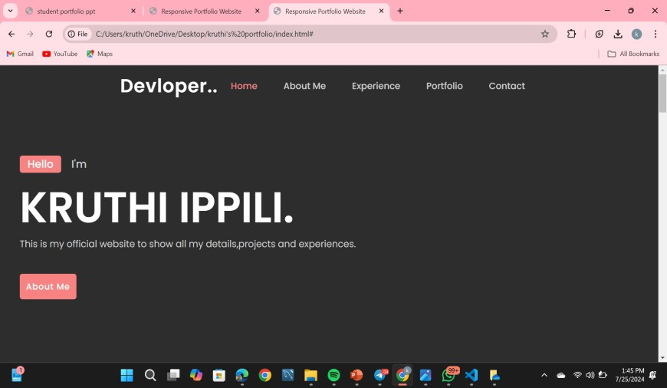
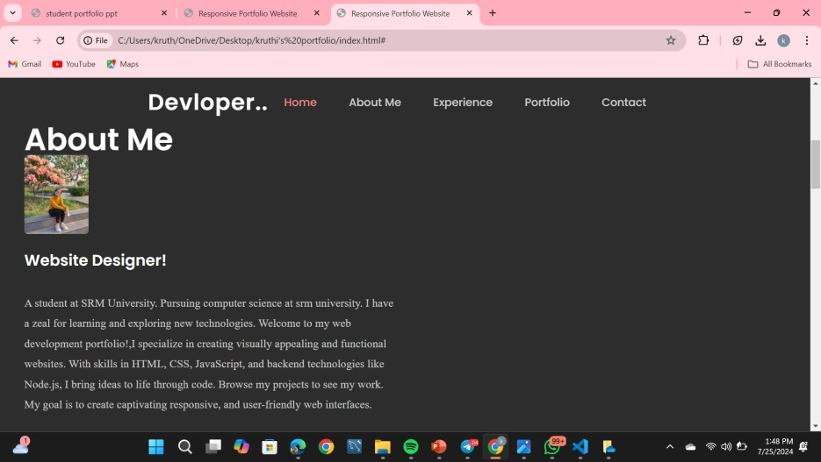
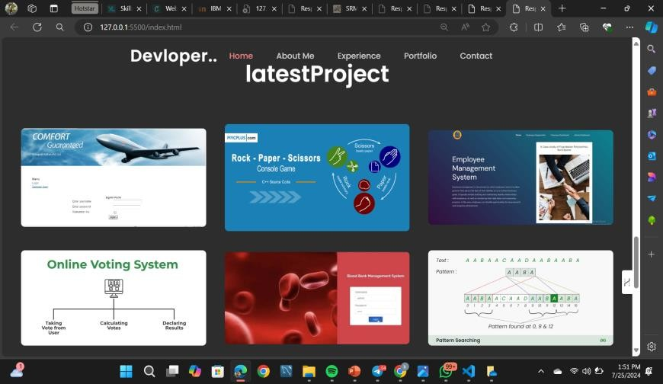
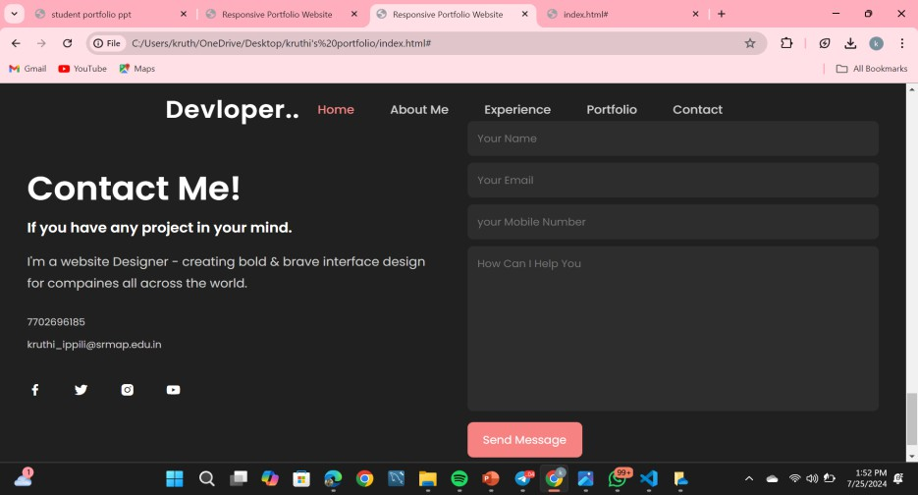
RESULTS

Slide 11
RESULTS
Visual Appeal: A clean and modern design that effectively showcases the student's skills and projects.
User Experience: Easy navigation and responsive design ensure a seamless experience across all devices.
Functionality: Interactive elements and well-structured content provide a comprehensive overview of the student's capabilities.
Feedback: Positive responses from peers, professors, and potential employers

